Slide 1
Table Indexing for the .NET Developer
Denny Cherry
mrdenny@dcac.co
twitter.com/mrdenny

Slide 2
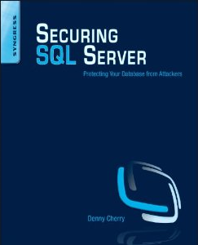
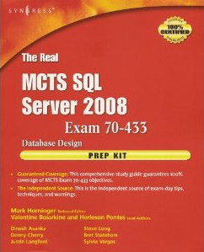

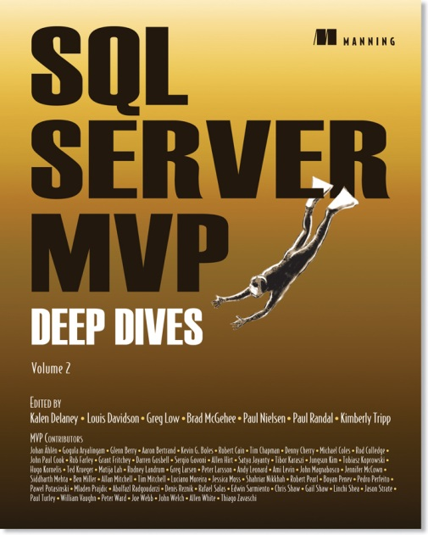




About Me
Denny Cherry & Associates Consulting
Author or Coauthor of 7 books
8+ SQL Mag articles
Dozens of other articles
Microsoft MVP
Microsoft Certified Master
VMware vExpert
Microsoft Certified Trainer

Slide 3
Today’s Goals
Introduce the different kinds of indexes
Common Misconceptions about indexes
Downsides to indexes
Introduce advanced index tuning techniques
Q & A

Slide 4
Today’s Goals
Introduce the different kinds of indexes
Common Misconceptions about indexes
Downsides to indexes
Introduce advanced index tuning techniques
Q & A

Slide 5
Different Kinds of Indexes
Five Kinds of Indexes
Clustered
Non-clustered
Full Text
XML
ColumnStore Indexes
There’s new stuff coming in SQL Server 2012
Semantic Search

Slide 6
Clustered Indexes
1 Clustered Index per table
Contain Full Copy of row data within in the index
Up to 16 indexed columns can be part of the index
(15 if the table contains any XML indexes)
Primary Key will by default be the Clustered Index
Must be created on the same filegroup as the table
Clustered Indexes should be as narrow as possible
While not required, they are highly recommended

Slide 7
Non-clustered Index
Up to 999 per table Starting with SQL Server 2008
255 in SQL Server 2005 and below
Up to 16 indexed columns in the index
Non-indexed columns can be included via INCLUDE statement
Non-Clustered indexes always contain the clustered index columns (when table has a clustered index)
When table is a heap, the Row ID is stored in every non-clustered index.
Can be created on any filegroup within the database
Can be filtered indexes to include fewer rows in the index.
Notes:
The number of indexes has not been changed as of SQL Server 2012 CTP3

Slide 8
Differences between unique and non-unique clustered indexes
Non-Unique clustered indexes have an extra column called the uniqueifier which ensures that values within the index are unique.
Uniqueifier is only used for rows which are not unique.
EmpId | Uniqufier
1
2
3
4 | 0
4 | 1
5
6
7 | 0
7 | 1
8

Slide 9
Full Text Indexes
Not accessed via normal SELECT statements
Require use of a predicate:
CONTAINS
CONTAINSTABLE
FREETEXT
FREETEXTTABLE
Can be used to search binary values (doc, docx, xls, pdf) stored within the database.
Natural Language Search
Can index XML documents, but only indexes the values, not the tags.

Slide 10
Full Text Indexes (SQL 2005 and below)
Created and managed outside of the database via Microsoft Search Service
Backed up with the database (starting in SQL 2005)
Searches entire index and returns all matches, which you then filter against your normal table to return correct set of rows.

Slide 11
Full Text Indexes (SQL 2008 and up)
Now stored within the database
Command is still parsed via MS Search service, but looking is done natively
Full text search now only searches the required subset of rows
When creating your indexes use an identity field as the key to improve query performance.

Slide 12
XML Indexes
Allows you to index specific nodes of the XML document
249 XML Indexes pre table
Requires a Clustered Index on the table
Each xml column can have a single primary XML index and multiple secondary XML indexes
XML Indexes can only be created on a single XML Column
No online rebuilds
Not available for XML variables. Only used on tables.

Slide 13
Primary XML Index
When created creates a hidden node table
Contains base table primary key and 12 columns of info about every node within the XML value
Effectively the clustered index on the node table
Base Table Clustered Index Value
Node id from the node table
Increases storage 200-500%

Slide 14
Secondary XML Indexes
Non-Clustered Indexes on the hidden node table
Three kinds of secondary indexes
PATH index on the node id (path) and the value
VALUE index is on the value and the node id (path)
PROPERTY index is on the base table’s clustered index, node id (path) and the value

Slide 15
Today’s Goals
Introduce the different kinds of indexes
Common Misconceptions about indexes
Downsides to indexes
Introduce advanced index tuning techniques
Q & A

Slide 16
Common Misconceptions about indexes
Indexes don’t require maintenance
If I create one index for each column in my where clause I’ll be fine
The table is sorted based on the order of the Clustered Index
Clustered Indexes are required

Slide 17
Today’s Goals
Introduce the different kinds of indexes
Common Misconceptions about indexes
Downsides to indexes
Introduce advanced index tuning techniques
Q & A

Slide 18
Downsides to indexes
Indexes take up space
On large complex databases the indexes can take up more space than the table
Data is duplicated in each index which contains the column
Indexes slow down insert, update, delete (especially full text indexes) statements
Using the wrong index can be slower than using no index
Encrypted data can’t be effectively indexed

Slide 19
Today’s Goals
Introduce the different kinds of indexes
Common Misconceptions about indexes
Downsides to indexes
Introduce advanced index tuning techniques
Q & A

Slide 20
Advanced Index Tuning Techniques
Fillfactor
Tells the SQL Server how much free space to leave in the leaf level pages.
Padding
Tells the SQL Server to use the Fillfactor setting to leave free space in the intermediate-level pages.
Online Rebuilds
Data Compression

Slide 21
What is a ColumnStore Index?
Totally new and different approach to indexing
Data is stored via columns not rows
Each column is stored separately, then compressed using VertiPak compression engine
SQL Server’s first B-Tree less index

Slide 22
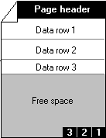
How does ColumnStore do that?
Existing Pages
C1
C2
C3
C4
C5
C6
Needed Columns
Notes:
As the column store index is scanned looking for matching values the min and max values are looked at to see if that row group needs to be scanned at all based on the WHERE clause of the query.
Data is not sorted
There is no such thing as a key in a column store index

Slide 23
ColumnStore: Use Case
Data continues to grow, but performance requirements stay the same
Many data warehouses approach PB ranges
Data needs to be filtered, aggregated, and grouped despite the size of the dataset

Slide 24
Limitations
Unsupported Data Types include
Uniqueidentifier
Blob
Numeric (19,2) or higher
Read Only
OUTER JOINs using ColumnStore don’t perform well

Slide 25
Column Store
Demo!

Slide 26
Using the Advanced Index Tuning Techniques
CREATE INDEX MyIndex ON dbo.MyTable
ON (Col1, Col5, Col3)
INCLUDE (Col4, Col2)
WHERE Col6 = ‘Value3’
WITH (FILLFACTOR=70, PAD_INDEX=ON, ONLINE=ON, DATA_COMPRESSION = ROW | PAGE);

Slide 27
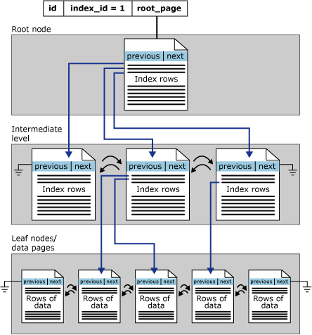
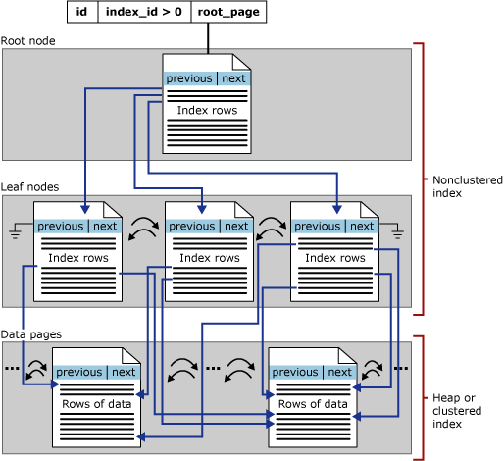
Physical Index B-Tree Layout
Clustered (BOL 2005 / 2008)
Non-Clustered (BOL 2005 / 2008)

Slide 28
How large are my indexes?
SELECT *
FROM sys.dm_db_index_physical_stats (db_id(), object_id(‘table_name’), null, null, ‘detailed’)
Database Id
Object Id
Index Id
Partition Number
Mode (NULL | Limited, Sampled, Detailed)

Slide 29
What Indexes are being used?
DECLARE @dbid INT
, @dbName VARCHAR(100);
SELECT @dbid = DB_ID()
, @dbName = DB_NAME();
WITH partitionCTE (OBJECT_ID, index_id, row_count, partition_count)
AS
(
SELECT [OBJECT_ID]
, index_id
, SUM([ROWS]) AS 'row_count'
, COUNT(partition_id) AS 'partition_count'
FROM sys.partitions
GROUP BY [OBJECT_ID]
, index_id
)
SELECT OBJECT_NAME(i.[OBJECT_ID]) AS objectName
, i.name
, CASE
WHEN i.is_unique = 1
THEN 'UNIQUE '
ELSE ''
END + i.type_desc AS 'indexType'
, ddius.user_seeks
, ddius.user_scans
, ddius.user_lookups
, ddius.user_updates
, cte.row_count
, CASE WHEN partition_count > 1 THEN 'yes'
ELSE 'no' END AS 'partitioned?'
, CASE
WHEN i.type = 2 And i.is_unique = 0
THEN 'Drop Index ' + i.name
+ ' On ' + @dbName
+ '.dbo.' + OBJECT_NAME(ddius.[OBJECT_ID]) + ';'
WHEN i.type = 2 And i.is_unique = 1
THEN 'Alter Table ' + @dbName
+ '.dbo.' + OBJECT_NAME(ddius.[OBJECT_ID])
+ ' Drop Constraint ' + i.name + ';'
ELSE ''
END AS 'SQL_DropStatement'
FROM sys.indexes AS i
INNER Join sys.dm_db_index_usage_stats ddius
ON i.OBJECT_ID = ddius.OBJECT_ID
And i.index_id = ddius.index_id
INNER Join partitionCTE AS cte
ON i.OBJECT_ID = cte.OBJECT_ID
And i.index_id = cte.index_id
WHERE ddius.database_id = @dbid
ORDER BY 1,
(ddius.user_seeks + ddius.user_scans + ddius.user_lookups) ASC
, user_updates DESC;
Don’t worry, you can download this from my blog, or from sqlfool.com (where I stole it from).

Slide 30
More Reading…
http://dcac.co/res/table-indexing-net

Slide 31
Q & A

Slide 32
Denny Cherry
mrdenny@dcac.co
http://www.dcac.co
http://www.twitter.com/mrdenny
Please rate my presentation at http://speakerrate.com/mrdenny

